Slide 1

What is Emile Spelling?
Helping Children Become Confident Spellers

Slide 2
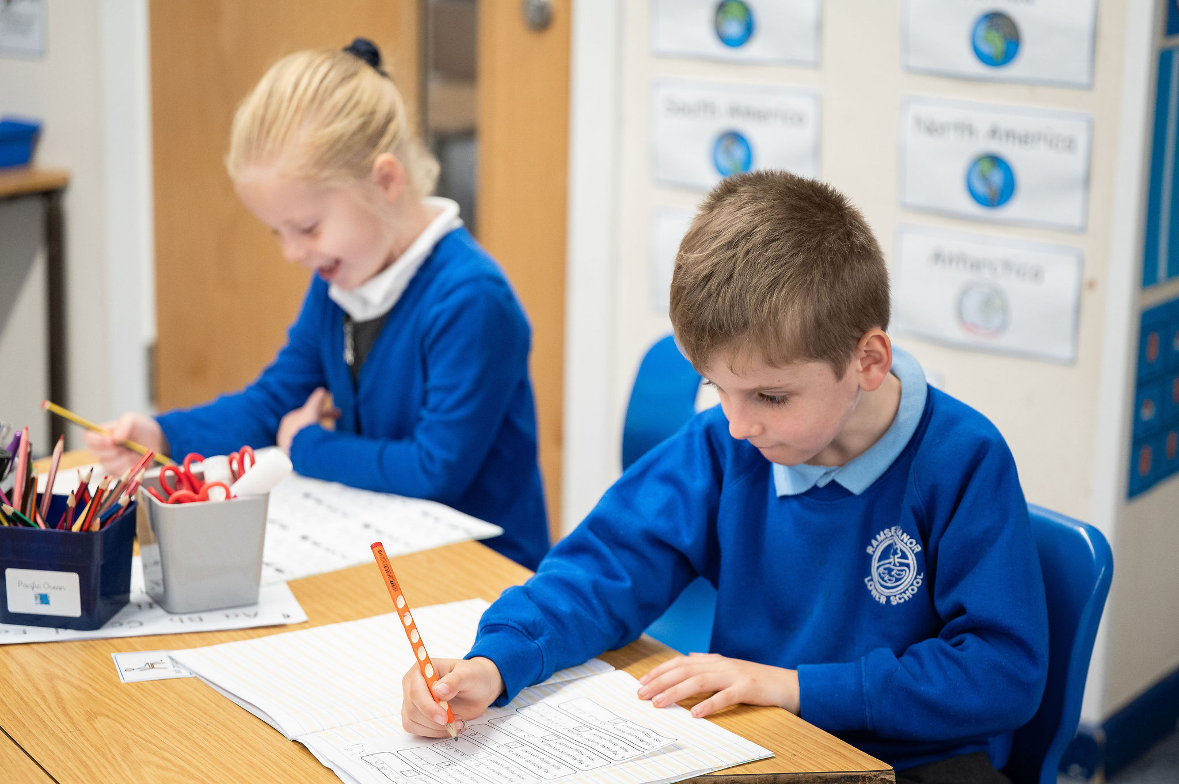
Why Spelling Matters
Spelling is key to reading, writing, and communication.
Good spelling builds confidence and helps in school and beyond.
Emile Spelling supports children's progress step-by-step, providing a structured pathway from early learning through to confident mastery.
Notes:
It forms the foundation of literacy and helps children express themselves clearly.
opening doors to academic success and effective self-expression.

Slide 3

What is the Emile Spelling Scheme?
Comprehensive Programme
Curriculum-Aligned
A complete spelling curriculum for Years 1 to 6, covering all key stages of primary education
Based on the UK National Curriculum Appendix 1, ensuring children learn exactly what they need
Research-Backed
Widely Trusted
Developed with Manchester Metropolitan University research, proven effective through rigorous testing
Used by over 2,000 schools across the UK, with thousands of successful learners

Slide 4
How Emile Spelling Works
Weekly Spelling Focus
Each week targets specific rules, prefixes, suffixes, and root words in a systematic progression
Rich Teaching Resources
Lessons include engaging PowerPoints, carefully selected word lists, and fun activities that keep children motivated
Deep Understanding
Children learn patterns, identify tricky parts, and explore word meanings—not just memorisation
Integrated Practice
Spelling practice is linked to reading and writing tasks, reinforcing learning across the curriculum

Slide 5

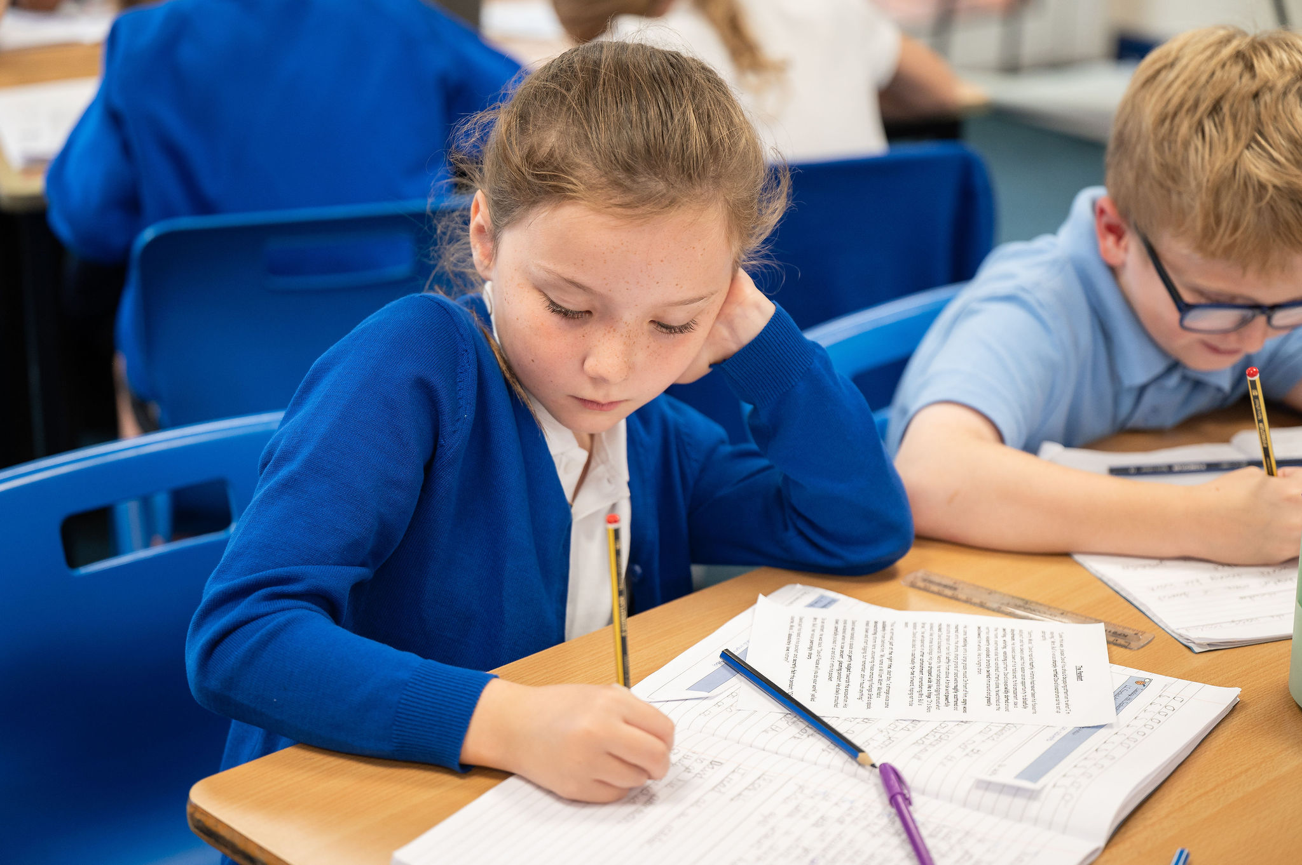
Teaching Approach
Lesson 1: Introduction
Introduce spelling rule and new words with engaging class discussion,
exploring patterns and connections together
Lesson 2: Application
Apply spelling through dictation and handwriting
practice, embedding the learning in authentic
contexts

Slide 6

Teaching Approach
Early Morning Work
Using the free website
At home learning
Using the free app / website

Slide 7

Supporting Children at Home
Weekly Practice
Spelling lists sent home for regular practice—just a few minutes each day makes a real difference
Parental / Carer Involvement
Encourage children by discussing word meanings and patterns—turn spelling into conversations
Spelling rules uploaded weekly to Google Classroom.
Low-Pressure Assessment
No weekly tests; progress checked with half-term
consolidation online tests in a game format, reducing
anxiety

Slide 8
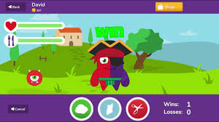

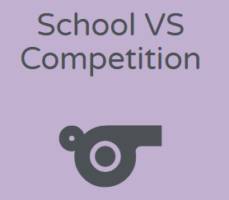
Emile's Digital Resources
Interactive Learning
Online games and interactive activities linked directly to lessons, making spelling practice feel like play rather than work
Flexible Access
Students can practise spelling at home or school on tablets, computers, or phones—learning fits around family life
Teacher Insights
Teachers track progress and identify areas needing extra support, ensuring no child falls behind
Competitions
National Spelling Competitions motivate and celebrate success, building confidence and enthusiasm

Slide 9
Real Impact: Success Stories
24%
2000+
Spelling Improvement
Schools Trust Emile
University of Manchester study shows 24% improvement in just 3 months of using Emile
Over 2,000 schools across the UK report rapid progress and increased student engagement
"Children enjoy the gamified learning and friendly competitions. We've seen remarkable progress in spelling confidence and ability across all year groups."

Slide 10
Going forward…
Use this spelling platform in Year 4 for the Autumn 2 and Spring term.
In February, we will ask for some parent and child feedback via Google.

Slide 11

How to log in…
Use the same log in details as TTRockstars
Free app – Learn with Emile
Website: https://games.emile-education.com/login

